Slide 1
Verification and Validation in Model Based Design
Presenter: Sang-Ho Yoon
Senior Application Engineer

Slide 2
Today’s Agenda
Introduction to V&V in Model-Based Design
Verification Activities in MBD
Model Verification
Design Review
Static Analysis
Dynamic Test
Code Generation and Verification
Code Review
Static Analysis
Equivalence Test
Questions and Answers
Notes:
Review agenda and timing.

Slide 3
Introduction to V&V in Model-Based Design
윤 상 호
Senior Application Engineer

Slide 4
Development Process
Verification and Validation
Requirements
Ind. Standards
User Acceptance Testing
Requirements
Complete
Integration
& Test
Integration testing
Environment
System-Level
Specification
Physical
Components
System-Level
Integration & Test
Algorithms
Code Verification and Validation
Subsystem
Design
Generate
Subsystem
Integration & Test
C, C++
HDL
MCU
DSP
FPGA
ASIC
Subsystem
Implementation
Notes:
So to explain model based design we first need to look at the problems typically associated with a traditional development process.
We will use a design V, common in Automotive and familiar in some Aerospace companies and other industries.
The “V” is a 2D view of a development process – the x-axiz is time, while the y-axiz is abstraction. As you move down the left hand side of the V you add more and more details to the design with implementation at the vertex. As you move up the right hand side of the V, you do higher and higher levels of integration and test with final working products at the end.
[Build, step through animation]
We can generalize this process into the phases of specification, designing, implementing, and testing,
Additional notes
Projects start with a definition of the requirements of the product to be created.
This set of requirements leads to a specification of the system. Then each subsystem is designed and implemented. How this is done depends a lot on the product involved and its complexity. We won’t try to capture all possible ways that this can be accomplished. But as you move further down, you add additional detail. With implementation at the Apex.
With all subsystems designed and implemented, integration and test begins, at higher and higher levels, leading ultimately to a final, working product.

Slide 5
Price of Late Verification and Validation Relative Cost to Fix Defects
High cost of fixing defects detected late
Difficult to know when “enough” testing is done
As design complexity increases, time and cost to test does too
Relative Cost to Fix Defects per Phase Found
50
45
40
35
30
Relative Cost
25
to Fix
Defect
20
Type
15
Requirements
10
Design
5
Code
Test
0
Design
Code
Test
Requirements
Phase Found
Test
Code
Design
Requirements
Source: Return on Investment for Independent Verification & Validation, NASA, 2004.

Slide 6
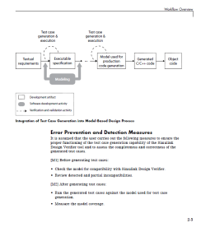
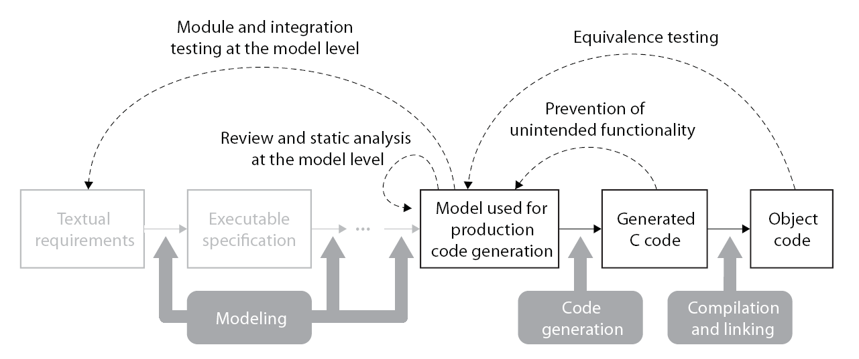
Reference Workflow for Verification and Validation in Model-Based Design
Model Verification
Code Verification

Slide 7
Verification Activities in MBD

Slide 8
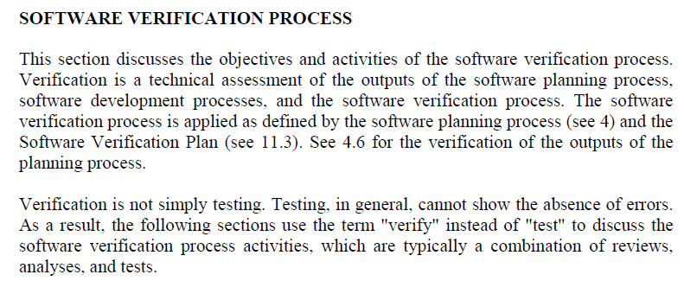
Verification in DO-178B/C
*DO-178C Section 6.0

Slide 9
Verification Activities in MBD
Model Verification
Design Review
Requirement Traceability
Report Generation
Static Analysis
Model Standards Checking
Design Error Detection
Prove Design Correctness
Dynamic Test
Simulation-based Functional Test
Coverage Analysis
Code Generation and Verification
Code Review
Code Inspection
Static Analysis
Code Metrics and Coding Rule Checking
Formal Verification (Abstract Interpretation)
Equivalence Test
SIL(Software-In-the-Loop) and PIL(Processor)
1
User Acceptance
Requirements
Model
Design
Integration
Code
2
Code

Slide 10
Model Verification

Slide 11
1) Design Review

Slide 12
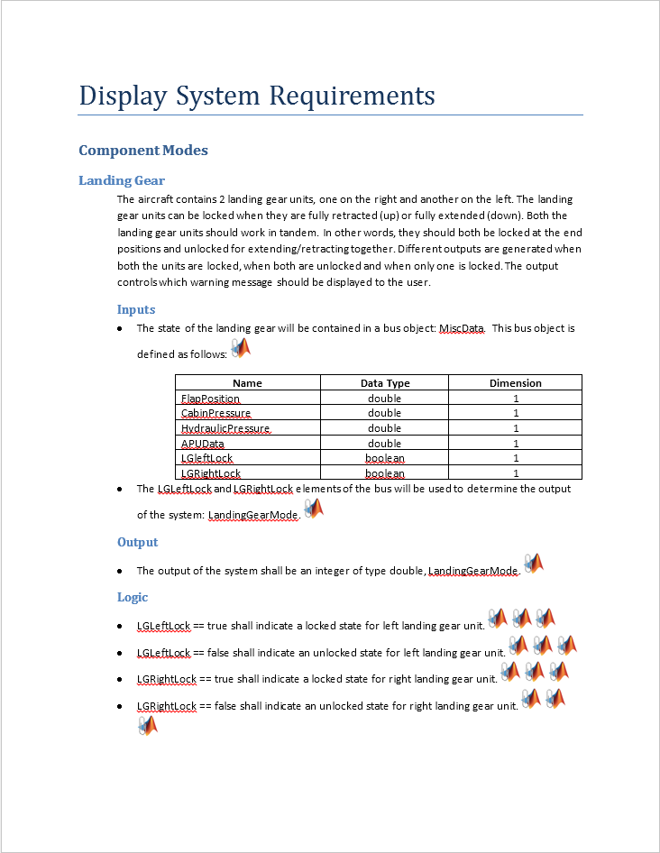
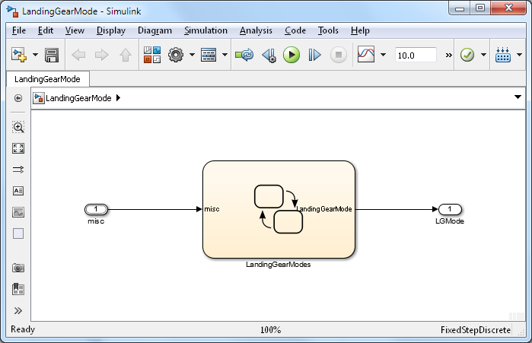
Algorithm Model
Functional Requirements
Model
Notes:
So we have created SBR algorithm model from the requirement!
>> sbr ( show the complete SBR algorithm model)
Do simple testing with constant blocks as inputs and display as output or
>>sbr_testHarness_simple

Slide 13
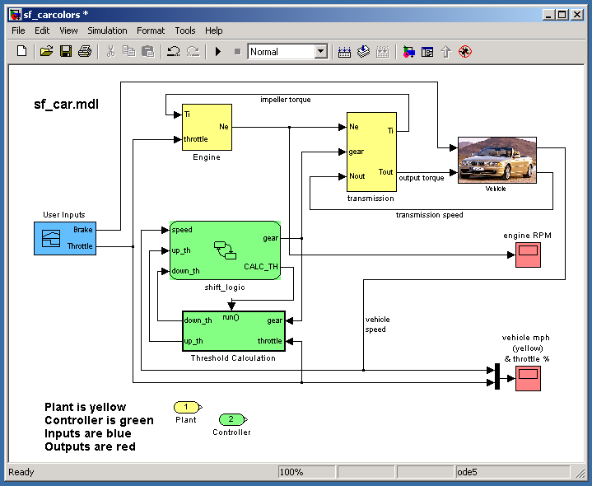
Traceability
Functional Requirements
Design
Environment
Physical Components
Tracing Requirements⬄Model Simulink® Verification and Validation™
Tracing Model⬄Source Code Embedded Coder™
Tracing Requirements⬄Source Code Simulink Verification and Validation
Algorithms
Hand- Generate
Generate
Generate
Digital Electronics
Embedded Software
VHDL, Verilog
C, C++
FPGA
ASIC
MCU
DSP
Integration
Implement
Notes:
The left side of the diagram represents the design process that goes from high level requirements, and design, elaboration and implementation. All the way to deployment on the target. (click)
Traditionally, the majority of the verification and validation effort happens at the SW and SW/HW integration phase. (click)
What we are going to focus on today are methods for early verification and validation that allow you to shift a portion of your V&V effort earlier in the development and allow you to find and fix problems earlier. These early V&V methods are enabled through the use of MBD and I hope that after this sess

Slide 14
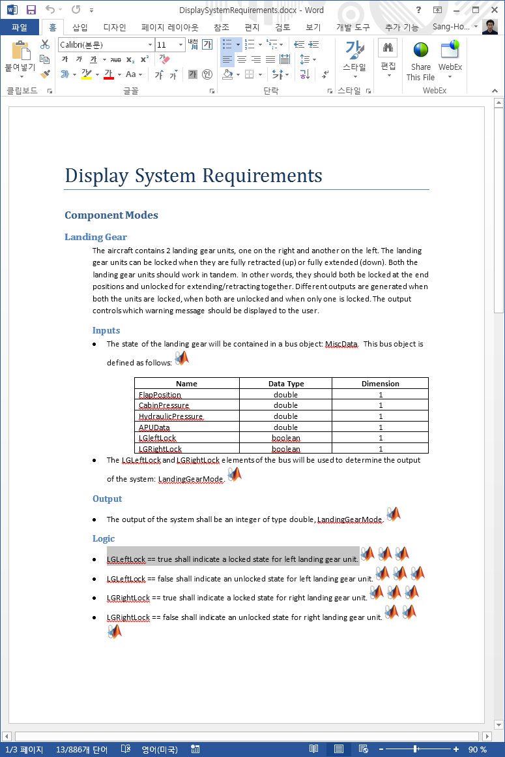
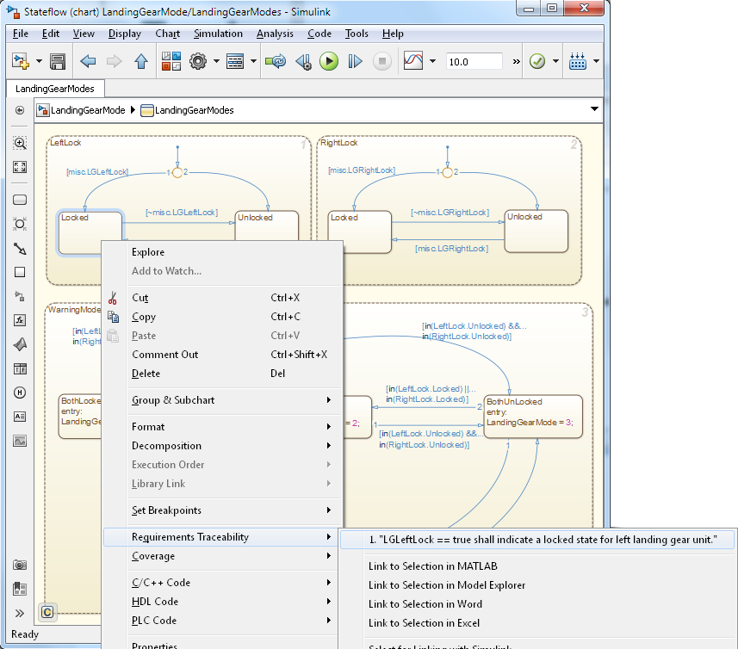
Tracing Requirements⬄Model Simulink Verification and Validation
Creating links between textual documents and model objects
Notes:
Suggestion for the presenter: Highlight the key features mentioned on the slide and then talk about the benefits of requirements linking – why is this important for the customer.
Typically requirements are scattered around in different documents, whether it is a managed environment, or not. Simulink and Stateflow models are used in conjunction with these predominantly textual documents to describe the details of the design. This situation raises many challenges – models and textual documents can get out of sync, it is difficult to navigate to the right requirement, especially if there are multiple versions of it – whether it is to review the latest revision, or to write a requirement.
To address these problems Simulink Verification and Validation provides an infrastructure that allows you to link a particular document paragraph to any block, state, or transition in the model. Typically this capability is used to assign high level requirements to subsystems, or low level requirements to specific implementation details, or even component tests in Simulink.
The supported format for textual documents are… (list)
The requirements linking capability has several features that can help you review traceability between the model and the text and if RTW-EC is used for code generation, linked textual information can be propagated to the generated code in form of code comments.

Slide 15
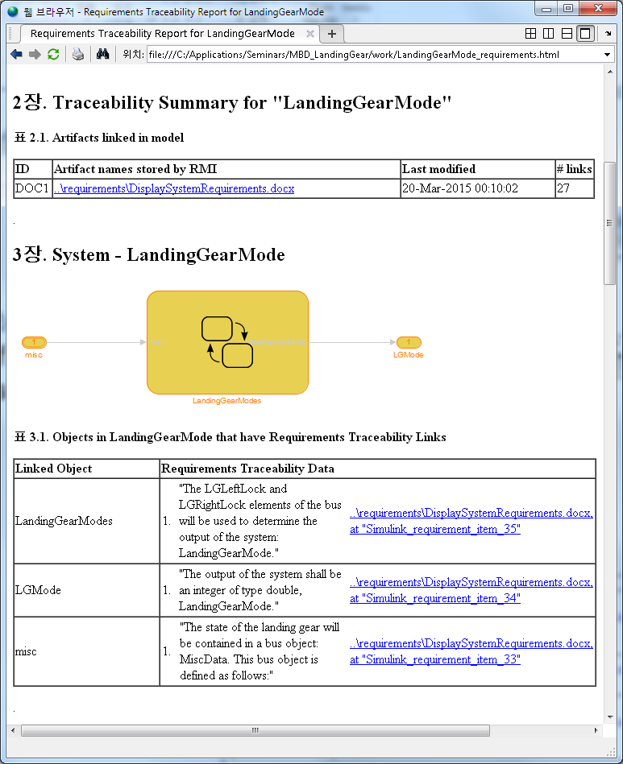
Requirements Traceability – Report Simulink Verification and Validation
Requirements Report provides screenshots of the model and lists all the associated requirements

Slide 16
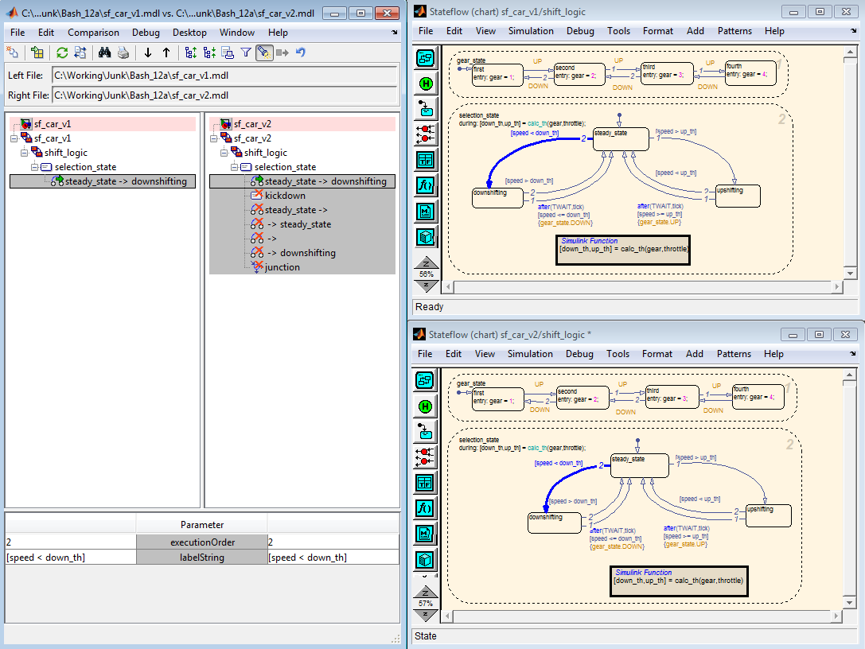
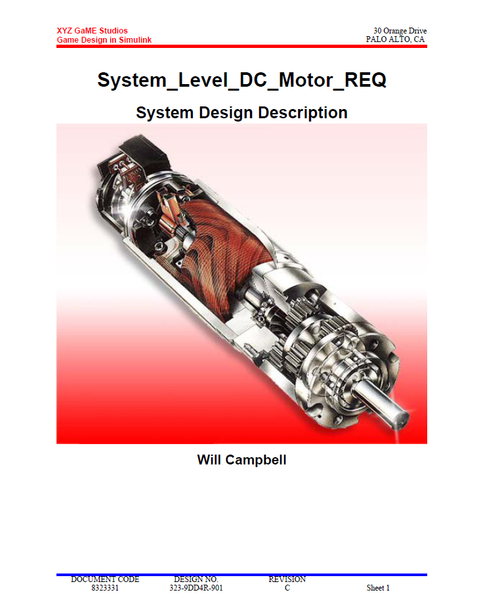
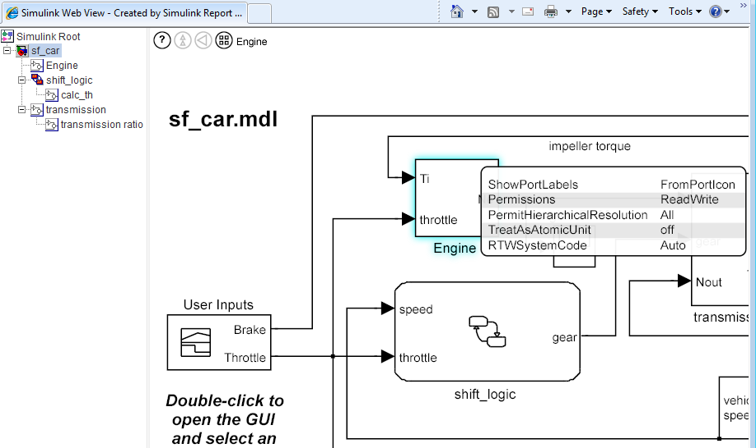
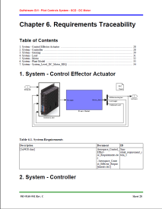
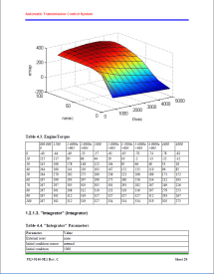
Report for Model Review Simulink Report Generator
Design and generate reports for MBD
Interactive design reviews
Model Comparison and Merge

Slide 17
2) Static Analysis

Slide 18
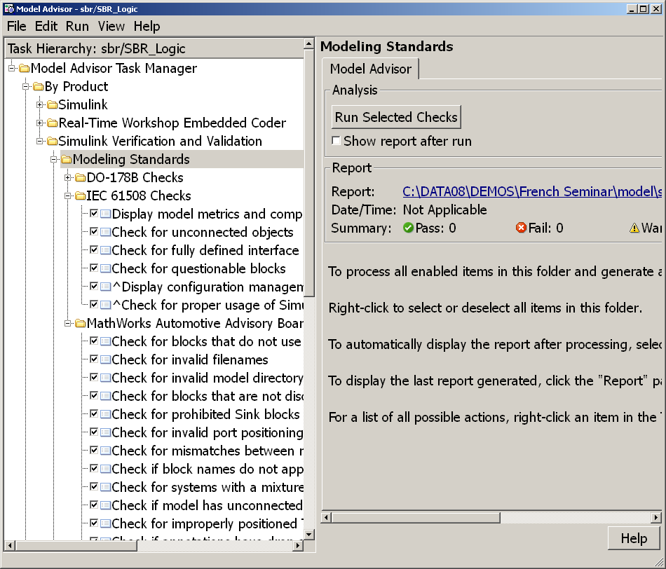
Modeling Standards Checking Overview Simulink Verification and Validation
Static analysis of models against a set of checks
Checks for simulation
Checks for code generation
Requirements Consistency
Modeling Standards
Modeling Standards Checks for:
MAAB Style Guidelines
DO-178B
IEC 61508
ISO 26262
Extensibility API

Slide 19
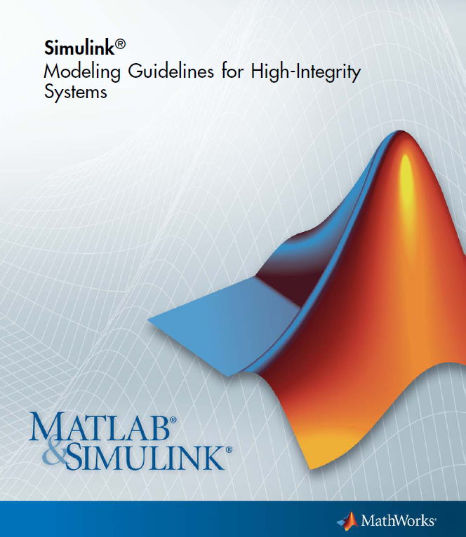
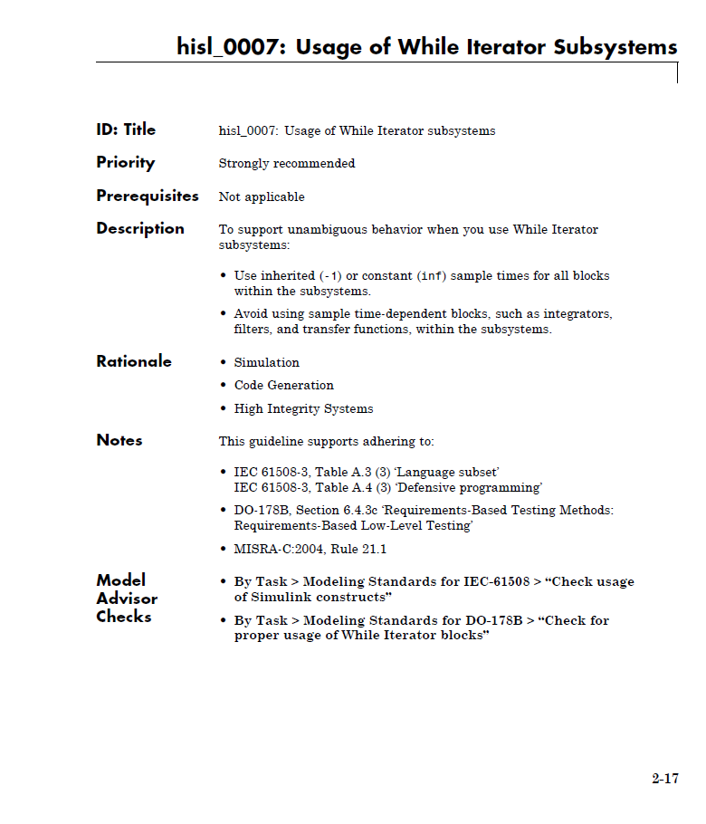
Modeling Guidelines for High-Integrity Systems
Leverage industry-best practices and MathWorks tool expertise when developing high-integrity systems
Modeling Guidelines and corresponding Model Advisor checks to facilitate modeling standards and guidelines objectives of ISO 26262, IEC 61508, DO-178B/C, and MISRA-C
http://www.mathworks.com/help/pdf_doc/simulink/hi_guidelines.pdf

Slide 20
Identifying Design Errors Early Simulink Design Verifier
Automatic identification of hard-to-find design inconsistencies in the model without running simulation
Integer overflow
Division by zero
Dead logic
Assertion violation
Notes:
This is new functionality in R2011a. Unlike with test generation, where simulation is used to run a number of tests and where outputs of the model need to be monitored and data analyzed in order to discover faulty behavior, as of R2011a a number of potential design problems can be detected automatically, before running simulation and before testing.

Slide 21
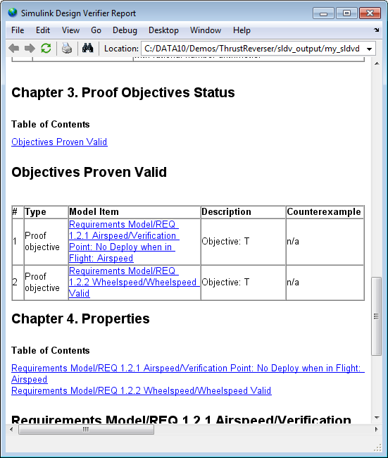
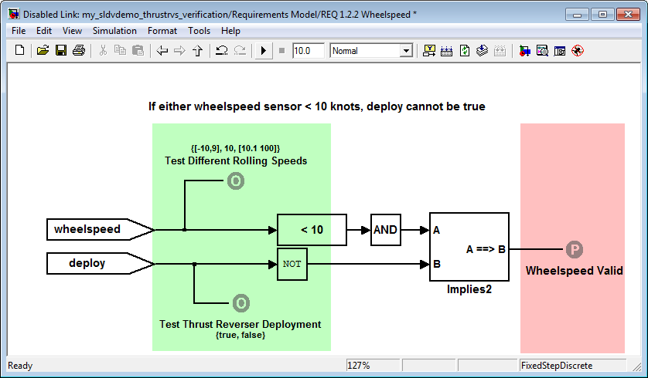
Verifying Design Against Requirements Simulink Design Verifier
Model Requirements
Prove Design Correctness
Must do
Must never do

Slide 22

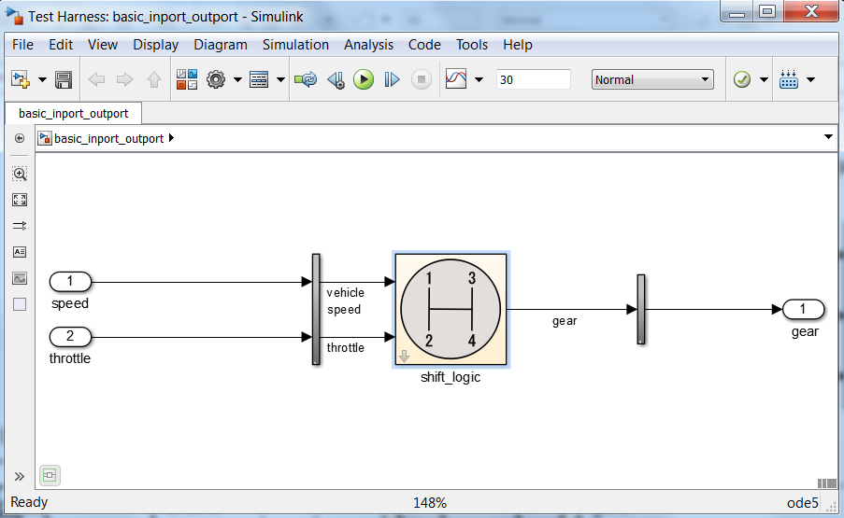
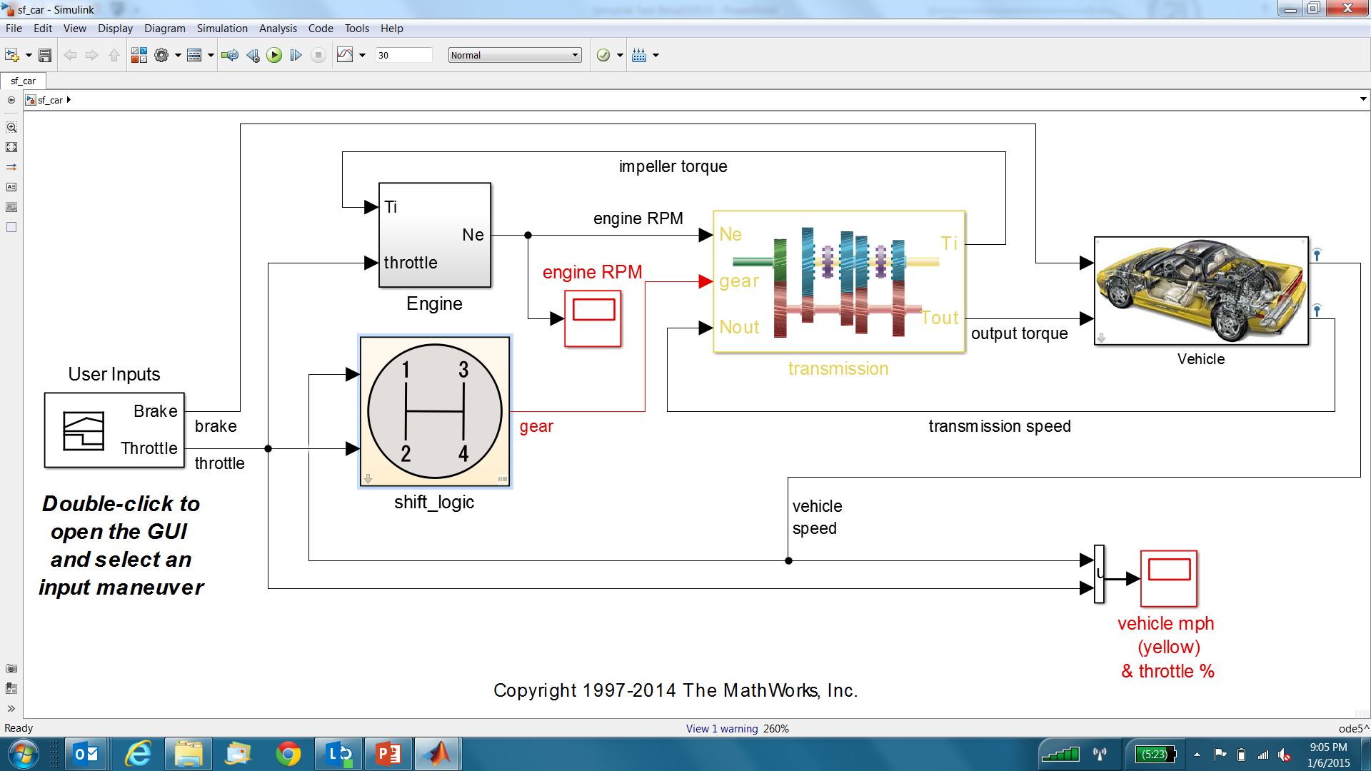
Simulink Test Tool for authoring, managing, and executing simulation-based tests
Test Harnesses
Synchronized testing environment
Enables unit testing without requiring new model
Component or system
Configure, build, simulate
Supports SIL, or PIL
Supports direct “adhoc” testing
Test Harness
Exercise
Component under test
Analyze
synchronized
Main Model

Slide 23
3) Dynamic Test

Slide 24
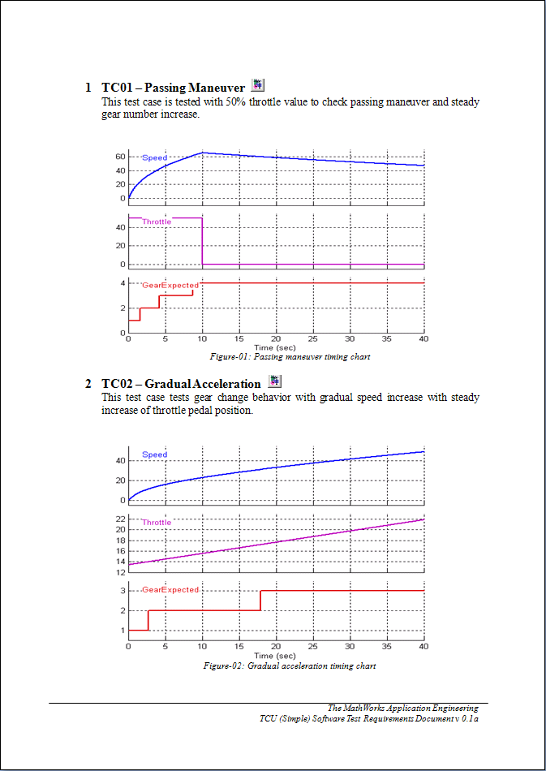
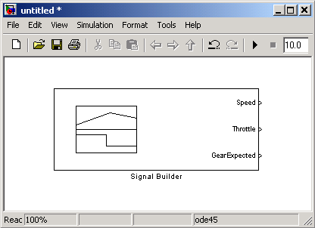
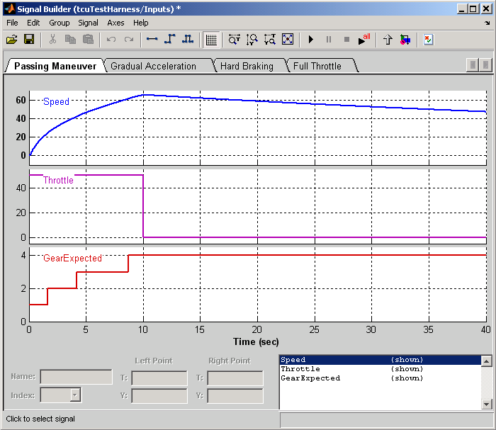
Test Cases to Signal Builder
Test Cases
Signal Builder
Notes:
Now is the time to revisit Testing Requirements. Revise the test cases in sbr_testing_requirements.doc.
First show how the first test case can be easily created using Signal Builder
Key : Constant at 0
SeatBeltFasten : Square wave at frequency 2
Speed : Triangle wave at default setting
SeatBeltIconExp : Constant at 0
Now, Let’s make use of the sbrTestCase.xls file.
Open xlsSignalGui
Push open button and select sbrTestCase.xls file
Press generate button
A Signal Builder block will be created into a Simulink model
# There is a bug on using commands to create Signal Builder block. After the block gets generated click all the test case tabs to overcome this issue!

Slide 25
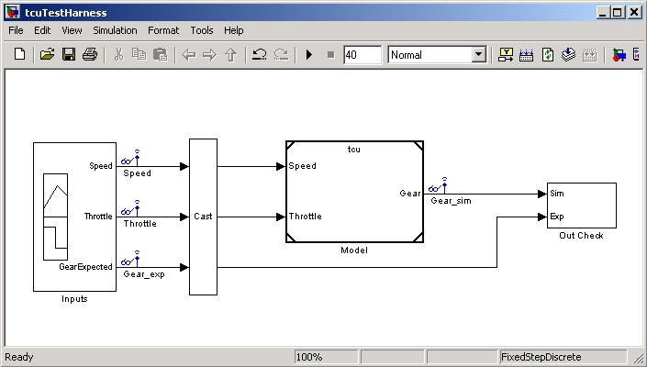
Module Test-Harness
Test Cases (Signal Builder)
Model
(Model Block)
Output Check (Assertion Block)
Test-Harness
Notes:
Three aspects of test-harness
Test Cases (Signal Budiler)
Model under test (Model Block can be used to bring sbr.mdl into the test-harness environment)
Output check (combination of relational operators and assertion block is being used)
>> sbr_testHarness
Open the Signal Builder block and explain about the assertion control
Test each test cases one by one
Error will be asserted on TC-04
Turn off the assertion and see the scope to check the difference between simulation result and expected result.
Open Model block parmeters and change sbr -> sbr_fix
Test TC-04 again and finish TC-05
Now the SBR model’s functional testing is done
It is time to talke about test automation and report generation

Slide 26
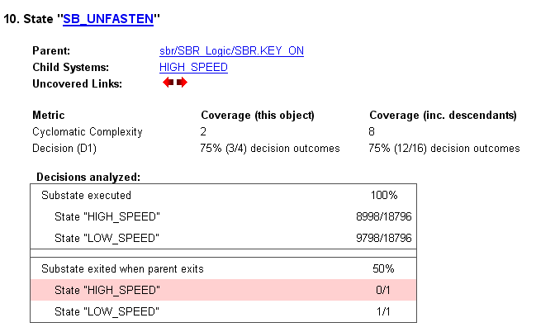
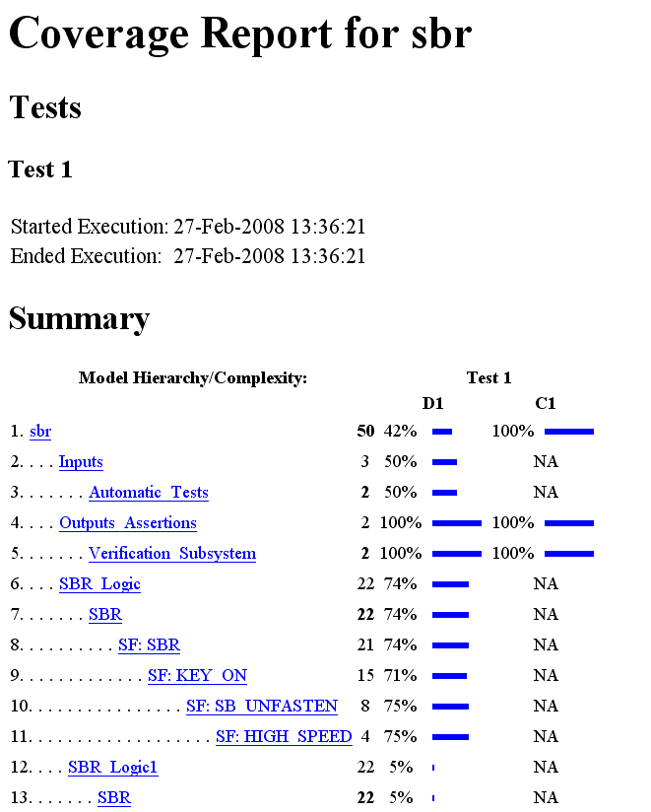
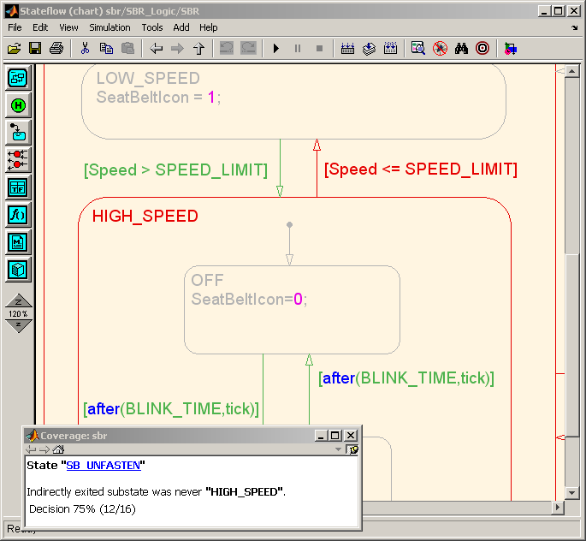
Model Coverage Report Simulink Verification and Validation
Coverage metrics identifies untested portions of your model

Slide 27
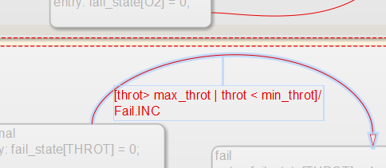
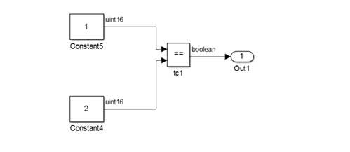
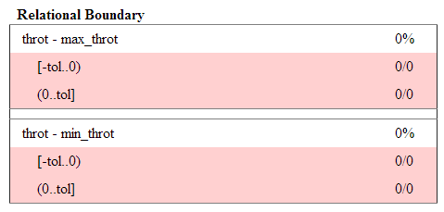
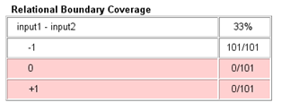
Relational Boundary Coverage (R2014b)
Verify testing around boundary points (Part of DO-178C)
Integer Relation
Floating-point Relation
Lhs just < Rhs
Lhs just > Rhs
Lhs just < Rhs
Lhs == Rhs
Lhs just < Rhs
Lhs just > Rhs
Lhs just > Rhs

Slide 28
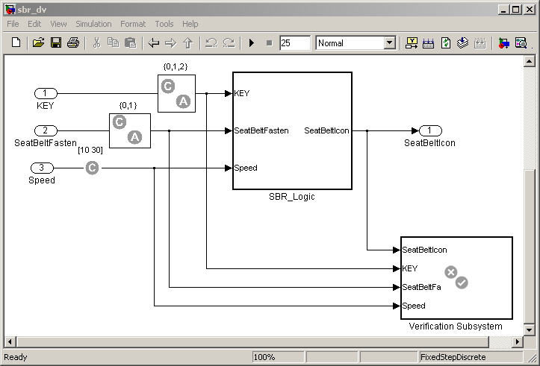
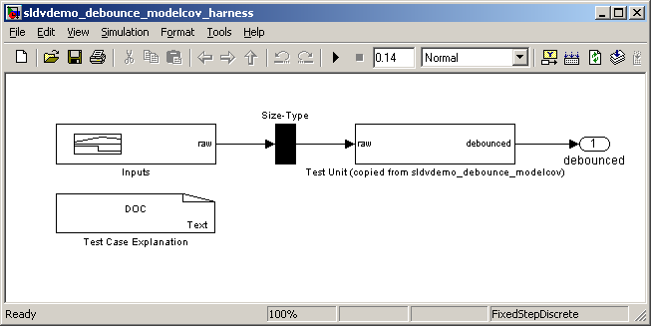
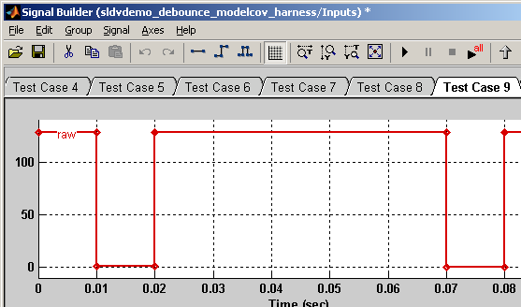
Improving Test Suite Simulink Design Verifier
Generating tests to reach coverage criteria
Test Generation
Test generation harness with the copy of the original model
Test inputs that ensure complete
coverage
Notes:
>> sbr_testGen
1) Generate test cases using DV.

Slide 29
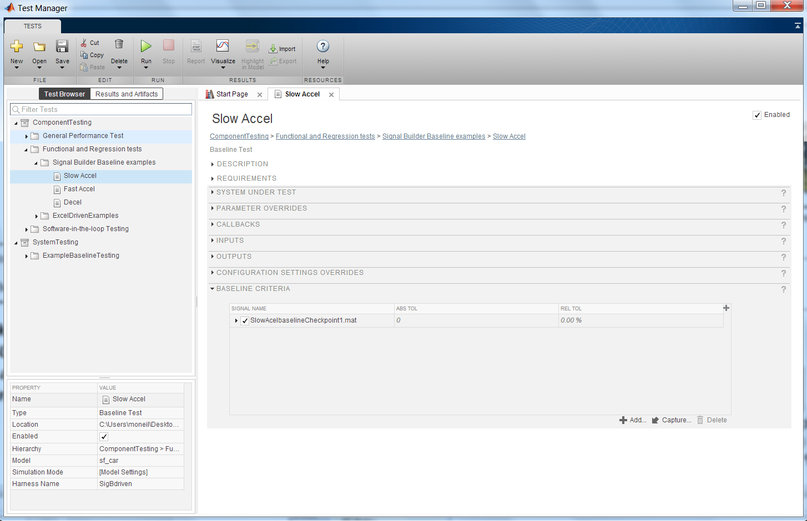
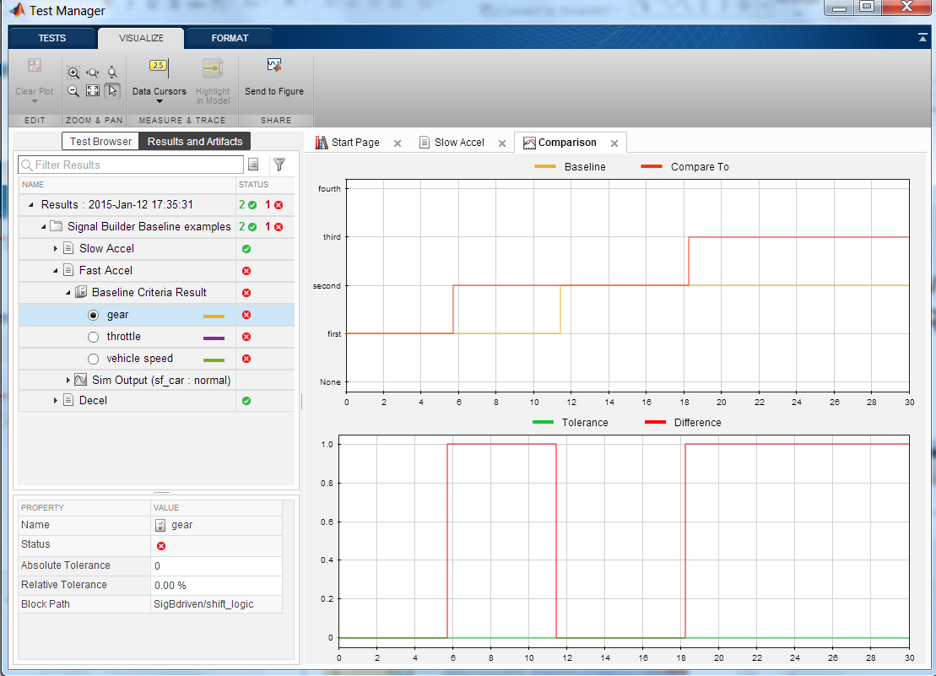
Simulink Test Tool for authoring, managing, and executing simulation-based tests
Test Manager
Create Test Cases
Group into Suites and Test Files
Execute individual or batch
View summary and detailed results
Archive, export, report

Slide 30


Test Case Templates
1. Simulation Test
Input
Output
Assessment Criteria
2. Baseline Test
Input
Output
Assessment Criteria
File
Expected
Outputs
3. Equivalence Test
Input
Output
Input
Output
Assessment Criteria

Slide 31
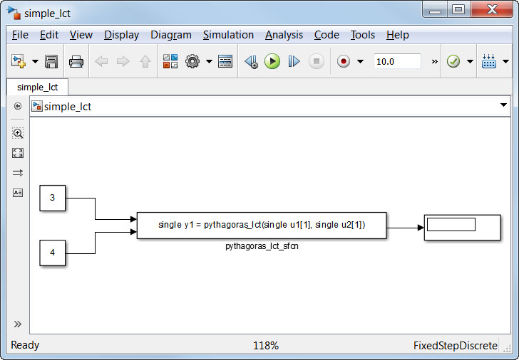
How about Legacy Code?
Use of Legacy Code Tool for introduction of existing C code on Simulink models
External C Function
MATLAB code
specification

Slide 32
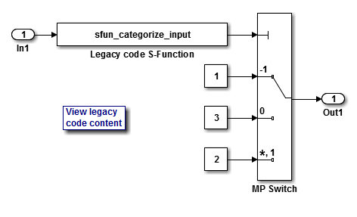
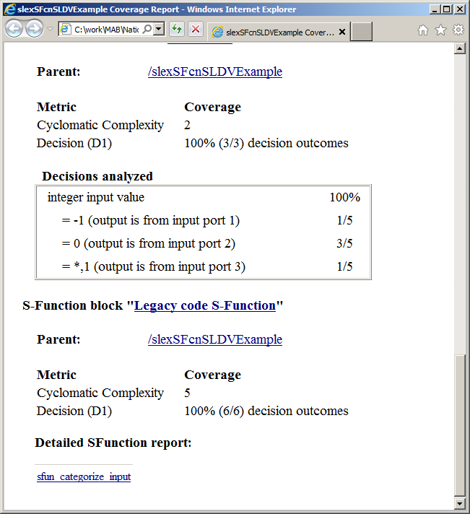
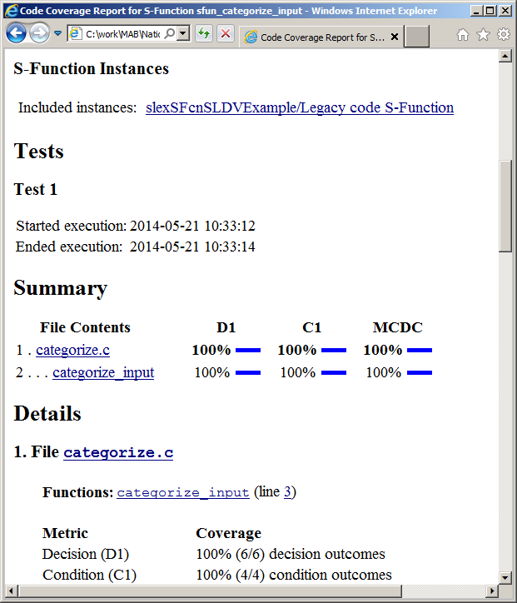
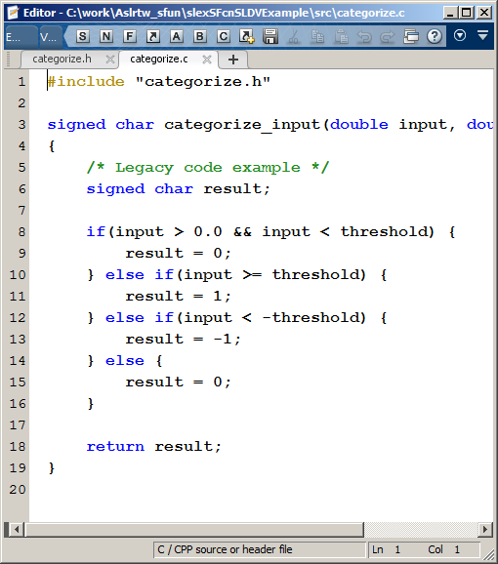
Coverage for C-code S-Functions
Design
Coverage
Model
C code
S-Function
Notes:
In coming releases we plan to extend coverage support to span both code and model aspects.
As a first step, in R2015a we expect to release model coverage extensions for C coded S-Functions. When your model contains instances of C coded S-Functions and you collect model coverage, the generated report will include coverage information for each instance of an S-Function with links to detailed code coverage for the aspects that are active during the model simulation.

Slide 33
Code Generation and Verification

Slide 34
Code Generation
Requirements
ISO ANSI-C production code generation with Embedded Coder.
Use of Legacy Code Tool to make a call to existing C code in generated code from Simulink models
HTML Report Generation for Review and Traceability
Design
Environment
Physical Components
Algorithms
Hand- Generate
Generate
Generate
Digital Electronics
Embedded Software
VHDL, Verilog
C, C++
FPGA
ASIC
MCU
DSP
Integration
Implement

Slide 35
1) Code Review

Slide 36
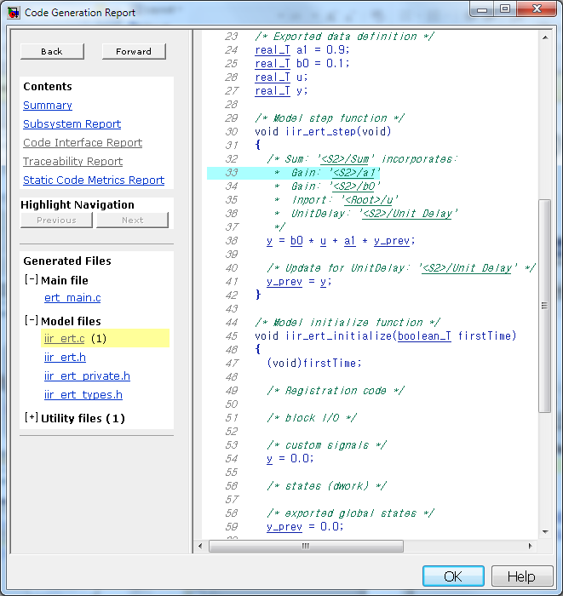
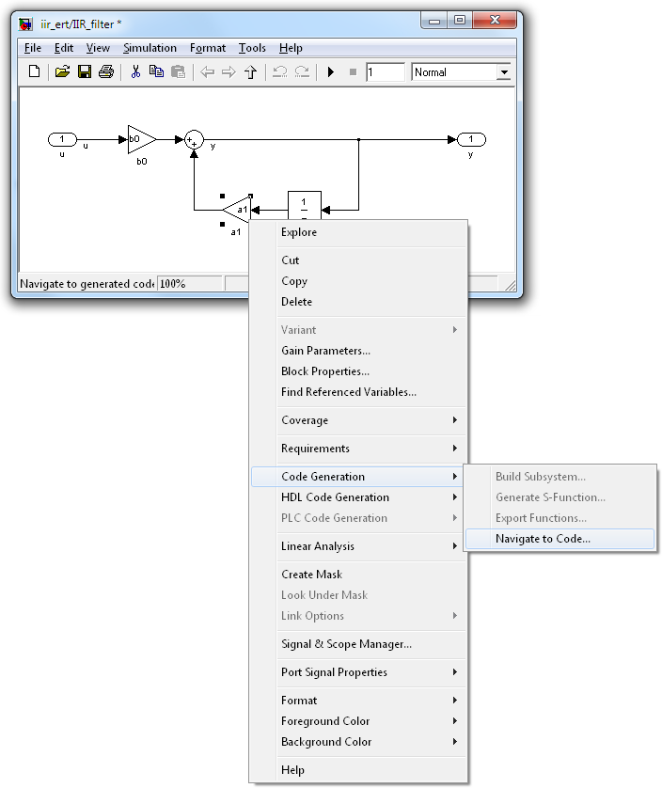
HTML Report
Hyperlink within
C code files.
Hyperlink back
to model.
Hyperlink from model to code.

Slide 37
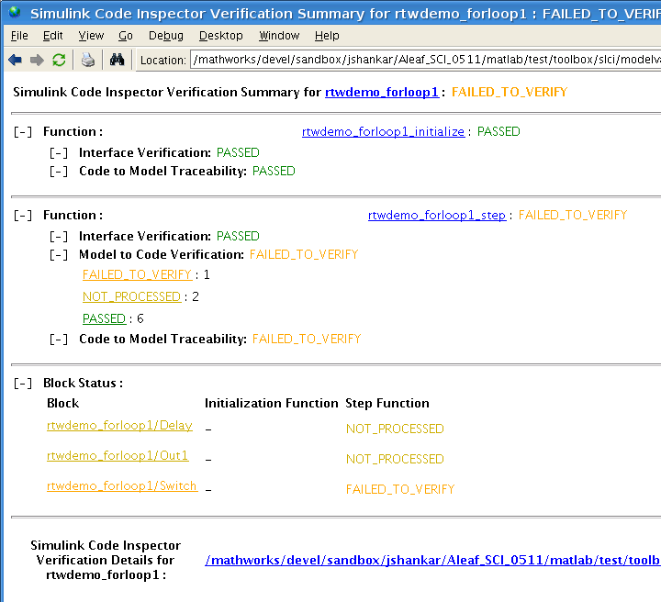
Simulink Code Inspector Automate DO-178B Code Reviews
Code
verification
Model
Source code
Independently verify that Embedded Coder generated code traces to and complies with low-level requirements
Demonstrate that model and source code match structurally and functionally
Provide model←→code traceability data
Eliminate / reduce manual code reviews for DO-178B software
Same certification credits as qualified code generator
Embedded Coder
Code traceability
Notes:
Must be suitable for customers as the slide will be made available for external use at the time of release.
Motivation
One or two sentences describing the problem in terms of how customers phrased or think of the issue. Consider both the feature and the workflow motivations.
Solution (Added Details)
More details as appropriate. How does it integrate with other features and products?
Doc Reference
In addition to release notes, which should be the source for most of the information on this slide. Add a doc reference if possible.
Demo
Shipping demo name
Limitations, Known Problems, and Workarounds
What are the current limitations? Are there problems end users are likely to run into? Are there Workarounds? Is anything likely to break, not just feature or product but interoperability with other products?
Questions and Debugging Tips (for MathWorks Support team)
What questions might end users ask?
What should Support try out when end users run into problems?
Are there any debugging tips or processes Support should follow?
Release Number – Tech Marketing to add icon closer to release date.

Slide 38
Simulink Code Inspector Overview
Model and code development
Simulink Model
C source code
Embedded Coder
Independent code inspection
Model IR
Code IR
IR transformations
Static verification tool, that checks the generated code against model
Automates DO-178B Table A-5 verification activities
Normalized Model IR
Normalized Code IR
Matching
Code inspection report
☒
?
☑
Traceability report

Slide 39
Meeting DO-178 Objectives Anticipated Certification Credits for Simulink Code Inspector with other code verification products
Code verification: Simulink Code Inspector
Code conformance: Polyspace
Model
Source code
Embedded Coder
Code traceability: Simulink Code Inspector
Annex A Table | Objective | DO-178B Ref. | Software Levels | Anticipated Certification Credit [Tool(s)]
A-5 | (1) Source Code complies with low-level requirements | Section 6.3.4a | A, B, C | Full [Simulink Code Inspector]
A-5 | (2) Source Code complies with software architecture | Section 6.3.4b | A, B, C | Full [Simulink Code Inspector]
A-5 | (3) Source Code is verifiable | Section 6.3.4c | A, B | Full [Simulink Code Inspector, Polyspace dead code analysis]
A-5 | (4) Source Code conforms to standards | Section 6.3.4d | A, B, C | Full [Polyspace MISRA-AC ACG rules checker]
A-5 | (5) Source Code is traceable to low-level requirements | Section 6.3.4e | A, B, C | Full [Simulink Code Inspector]
A-5 | (6) Source Code is accurate and consistent | Section 6.3.4f | A, B, C | Full (for source code based criteria) [Simulink Code Inspector, Polyspace verifier]

Slide 40
2) Static Analysis

Slide 41
Runtime Errors
Arithmetic errors
Found in (code)
Overflows, division by zero, bit-shifts, square root of negative numbers
Caused by (model)
Faulty scaling, changes in or unknown calibrations, untested data ranges coming out of a subsystem into an arithmetic block
Memory corruption
Found in (code)
Out of bound array indexes
Pointer arithmetic
Caused by (model)
Array manipulation in Stafeflow
Hand-written look-up table functions
Data truncation
Found in (code)
Overflows
Wrap around
Caused by (model)
Saturations leading to unexpected data flow inside the generated code
Coding errors
Found in (code)
Non initialized data
Dead code leading to unreachable transitions or states
Caused by (model)
Faulty Stateflow programming

Slide 42
CATEGORY OF STATIC ANALYSIS OF USING TOOLS
Compiler Warnings
Code Metrics, and Coding Rules
Error Prevention
Error Detection
Bug Findings
Formal Methods
(False negative)
(No False negative)

Slide 43


Polyspace PRODUCTS
Compiler Warnings
Code Metrics, and Coding Rules
Polyspace Bug Finder
Polyspace Code Prover
Error Prevention
Error Detection
Bug Findings
Formal Methods
(False negative)
(No False negative)
Polyspace Bug Finder
Polyspace Code Prover

Slide 44
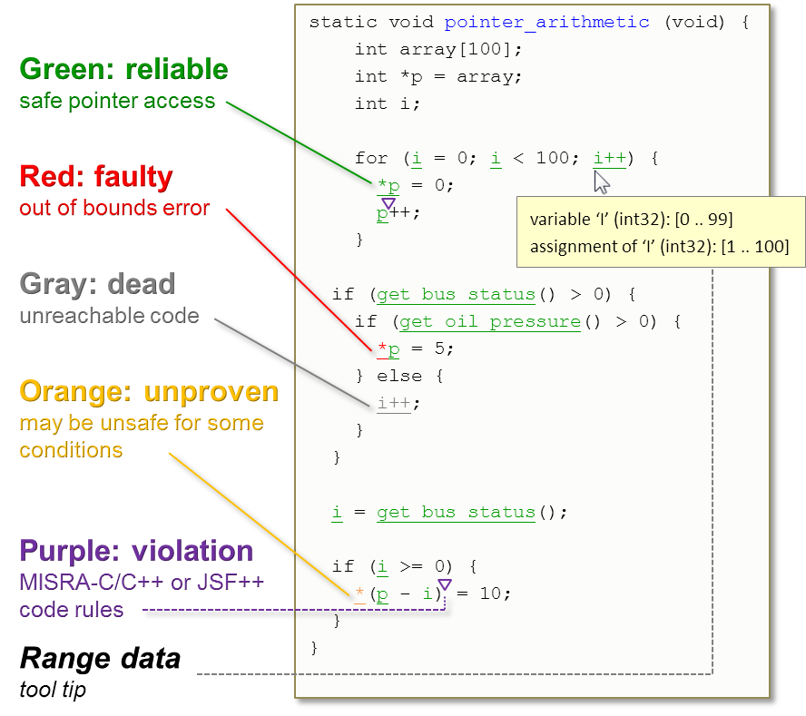
Polyspace Formal Methods based Static Code Analysis
Exhaustively verify code
Detect and prove absence of runtime errors
Precisely determines and propagates variable ranges
Languages supported
C, C++, and Ada
Verify SW robustness
Analyze for full range operating conditions
OR
Specified ranges of parameters and inputs

Slide 45
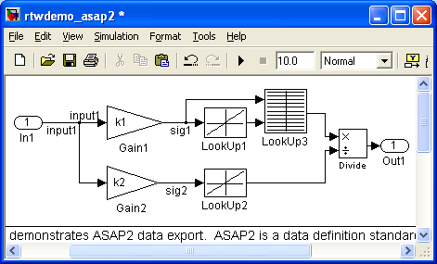
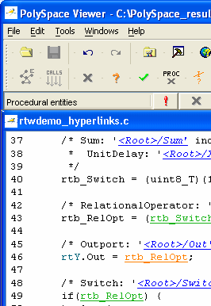
Tracing results back to the model PolySpace™ Model Link SL
Integrates code verification with the production code generation

Slide 46
3) Equivalence Test

Slide 47
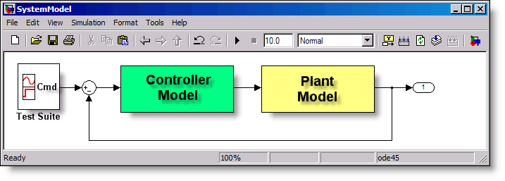

Software-in-the-Loop (SIL) Testing: Verify Production Controller with Software-in-the-loop
Code
Generation
Execution
Host/Host
Nonreal-time
Compiled C Code
S-Function
(Windows DLL)
Notes:
>> sbr_testHarness_SiL

Slide 48
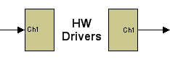


Processor-in-the-Loop Testing: Verify Production Controller with Processor-in-the-loop
Code
Generation
Execution
Host/Target
Nonreal-time
Production Processor
Notes:
Embedded IDE Link for TS has been used(C167)
>> sbr_testHarness_PiL

Slide 49
Standards Compliance
Notes:
[Timing: 15 minutes for Intro]

Slide 50
Traditional DO-178B/C Workflow
Verify
Test Cases & Review
Test Procedures & Review
Test Execution & Review
Code Coverage Tool
Validate
Requirements
Trace
Design Review
Text or
Graphics Editor
Conformance
Design Review
Verify
Design Review
Design
Trace
Code Review
Conformance
Code Review
Code
Verify
Test Cases & Review
Test Procedures & Review
Test Execution & Review
Code Coverage Tool
Source Code
Verify
Code Review
IDE
Object Code

Slide 51
Workflow Example with MBD
* DO-178C Qualifiable Tool
Validate
Verify
EC: PIL
SLRG
Polyspace*
Trace
SLVNV: RMI
SLRG: SDD *
Requirements
Trace
Simulink
Stateflow
SLRG: SDD *
Verify
Conformance
SLVNV: DO-178C/DO-331
Checks *
Verify
SLRG
SLVNV: Model Coverage *
Simulink Design Verifier
Conformance
Verify
Trace
Embedded Coder
Simulink Code Inspector*
Model
Trace
Conformance
PS:MISRA-C
Checks *
Embedded Coder
Abbreviations
SL: Simulink
SLVNV: Simulink Verification and Validation
RMI: Requirements Management Interface
SDD: System Design Description
SLDV: Simulink Design Verifier
SLRG: Simulink Report Generator
PS: Polyspace
RTE: Run-Time Error
EC: Embedded Coder
PIL: Processor-in-the-Loop
Conformance
Verify
EC: PIL
SLRG
Polyspace*
Source Code
Verify
Simulink Code
Inspector*
Verify
Verify
Compiler/IDE
Object Code

Slide 52
Questions?
Notes:
[Timing: 15 minutes for Intro]

